Slide 1
Draft revised Guidelines on ML/TF risk factors under Article 17, 18(4) AMLD
Public Hearing | 15 May 2020

Slide 2
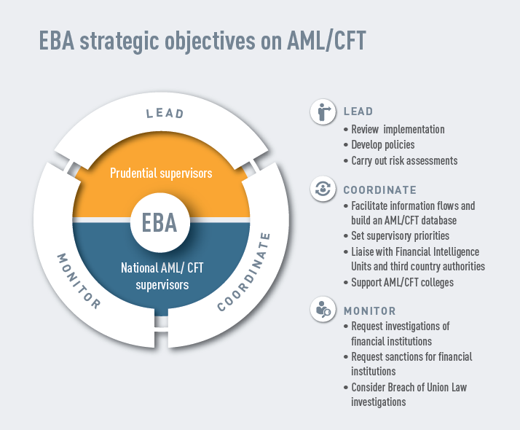
THE EBA’s NEW ROLE
Article 1(5)(fb) of the EBA Regulation (NEW):
‘The Authority shall, within its respective competences, contribute to […] preventing the use of the financial system for the purposes of ML/TF.’

Slide 3
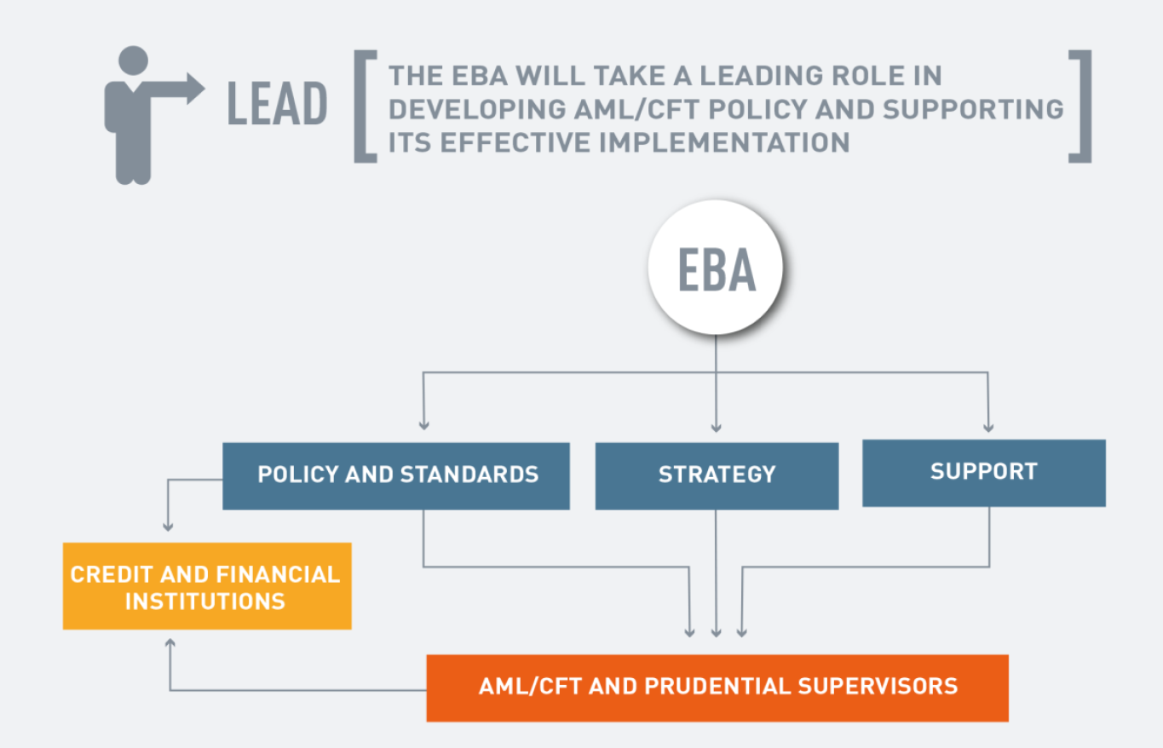

Slide 6
THE EBA’s LEGAL INSTRUMENTS AND MEASURES
Legal instruments
Regulatory technical standards
Guidelines and Recommendations
Opinions
Measures to support implementation
Training
Reviews (peer reviews, implementation reviews)
Breach of Union Law investigations
Cooperation with NCAs
New (since 2020)
Central AML/CFT objective
Central AML/CFT database
Article 9a risk assessments
Article 9b investigations
Outreach (FIUs, third countries)

Slide 7
THE EBA’s POLICY OBJECTIVE

Slide 8
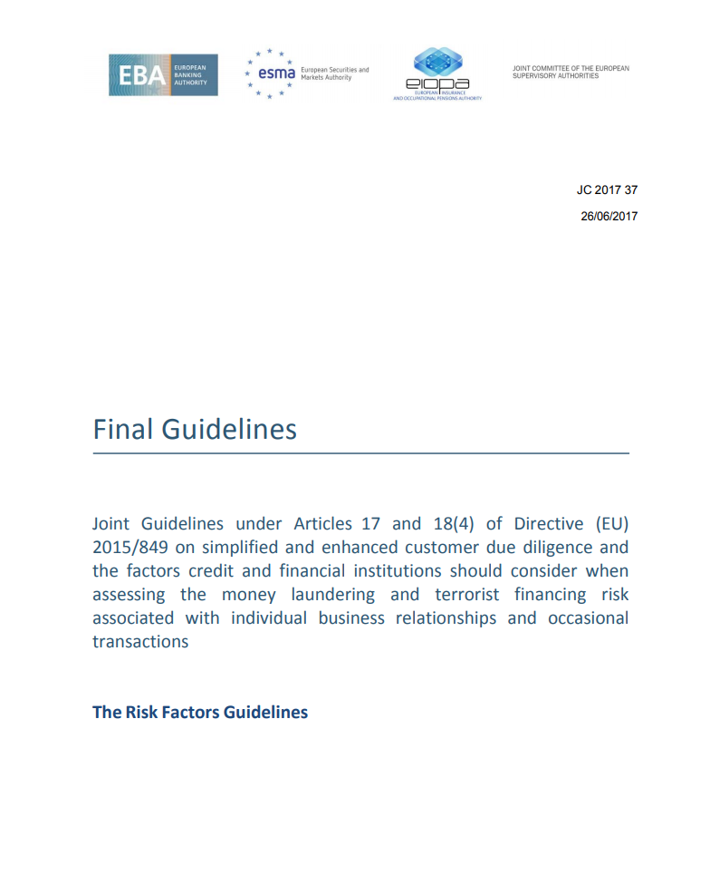
THE ORIGINAL RISK FACTORS GUIDELINES : OVERVIEW
Firms should use these Guidelines to:
Identify risk factors and assess ML/TF risk;
Adjust the type and extent of their CDD measures in line with that risk; and
Understand supervisory expectations.
Competent authorities should use these Guidelines to:
Assess the adequacy of firms’ AML/CFT policies and procedures; and
Inform the ML/TF risk assessment of their sector.
Published in June 2017; in force since June 2018

Slide 9
A COMMON UNDERSTANDING OF THE RISK-BASED APPROACH TO AML/CFT
RISK FACTORS
RISK ASSESSMENTS
RISK-SENSITIVE CDD
A PROPORTIONATE, RISK-BASED AND EFFECTIVE AML/CFT REGIME

Slide 10
THE DRAFT REVISED RISK FACTORS GUIDELINES : A REVIEW WARRANTED
Updated version in order to take into account:
Directive EU (2018/843) ‘AMLD5’;
New and emerging risks;
The outcomes of the EBA’s implementation review
The outcomes of the European Commission’s Post Mortem report

Slide 11
THE DRAFT REVISED RISK FACTORS GUIDELINES : MAIN CHANGES
New guidance on the compliance with the provisions on enhanced customer due diligence related to high-risk third countries;
More details on terrorist financing risk factors;
More details on customer due diligence (CDD) measures including on the identification of the beneficial owner, the use of innovative solution to identify and verify the customer’s identity;
Clear expectations of firms’ business-wide and individual ML/TF risk assessments;
Additional sector specific guidelines : crowdfunding platforms, corporate finance, payment initiation services providers (PISPs) and account information service providers (AISPs) and for firms providing activities of currency exchanges offices.

Slide 12
THE DRAFT REVISED RISK FACTORS GUIDELINES: CONSULTATION
The public consultation is open until 5 July 2020
The scope of the consultation is limited to the amendments and additions to the original Risk Factors Guidelines.
The draft revised Guidelines are at https://eba.europa.eu/calendar/draft-guidelines-under-articles-17-and-184-directive-eu-2015849-customer

Slide 13
THE DRAFT REVISED RISK FACTORS GUIDELINES : QUESTIONS/COMMENTS 1. Title I. General Guidelines. 2. Title II. Sector specific Guidelines. -New sector specific Guidelines: crowdfunding platforms, corporate finance, payment initiation services providers (PISPs) and account information service providers (AISPs), firms providing activities of currency exchanges offices -Existing Sector specific Guidelines.

