Slide 1
Item 2: The reporting landscape in the next years
Workshop on Integrated Reporting
1 December 2022

Slide 2
Outline
1
EBA reporting landscape
2
EBA reporting development base timelines
3
Expected changes to prudential and resolution reporting
4
EBA reporting development tentative timelines
5
Key messages

Slide 3
1. The EBA reporting landscape
Dynamic environment, continuous changes
CRD/CRR
IFR
relevant since these are integrated in the EBA data dictionary and processes
Prudential and financial reporting
BRRD
Investment firm reporting
Tight window for development, consultation and implementation
Resolution reporting
Other
New responsibilities:
DORA incident reporting, register of third party providers (2025) MiCA (2025)
Need to follow a certain consultation and decision process (authorities and public)
DPM - One single harmonized data dictionary for prudential and resolution reporting
Application dates of underlying rules drive development timelines

Slide 4
2. EBA reporting development base timelines
Preparation
Consultation
Finalisation
Implementation
Stages of development and timeline
6-9 months
3 months
6 months
12 months
Reporting starts
Publication of consultation Paper (BoS)
Final draft ITS (BoS) and submission to EC
Responses received
6 months
Decision and consultation process
SGREP
SCREDAT
New prudential rules in the OJ
Public Hearing
SGREP
SCREDAT
Technical package
(DPM, XBRL, VRs)
EC adoption
New prudential rules apply
SGREP – Sub Group on Reporting SCREDAT – Standing Committee on Reporting, Data analysis and Transparency EC - European Commission

Slide 5
3. Expected changes to prudential and resolution reporting 2023-2024/25
Changes to reporting requirements
Other changes
meant to increase the efficiency of the reporting process on EBA side
Reporting framework 3.3
IPU reporting
ESG ad-hoc pillar 3 data collection
Supervisory benchmarking
Based on existing templates, no new ITS
DPM ReFit implementation
New validation and transformations language implementation
Data Quality review of the current DPM
Other technical aspects (XBRL-CSV implementation)
Reporting framework 3.4
IRRBB reporting
FRTB
Resolution planning (ITS)
new ITS
Upcoming CRR3/CRD6
New reporting requirements: ESG reporting
Significant changes to: operational risk, output floor, credit risk, third country branches
Integration of disclosure requirements in the reporting frameworks (due to Pillar 3 data hub; necessary alignment with the Basel pillar 3 framework)
new ITS
Work in progress; to be gradually implemented starting with 2023

Slide 6
4. EBA reporting development tentative timelines
Need to consider the future collaboration within the JBRC and with the industry
Preparation
Consultation
Finalisation
Implementation
Stages of development and timeline
6-9 months
3 months
6 months
12 months
Reporting starts
6 months
Rough timeline for reporting framework v3.3
2023
Rough timeline for reporting framework v3.4
2022/2023
Q1 2023
Q2-Q3 2023
During 2023/2024
(depending on the topic)
Rough timeline for CRR3/CDR6 changes
2023/2024
during 2025
(CRR rules expected to apply from Jan.2025)
Transition to DPM refit and other technical changes

Slide 7
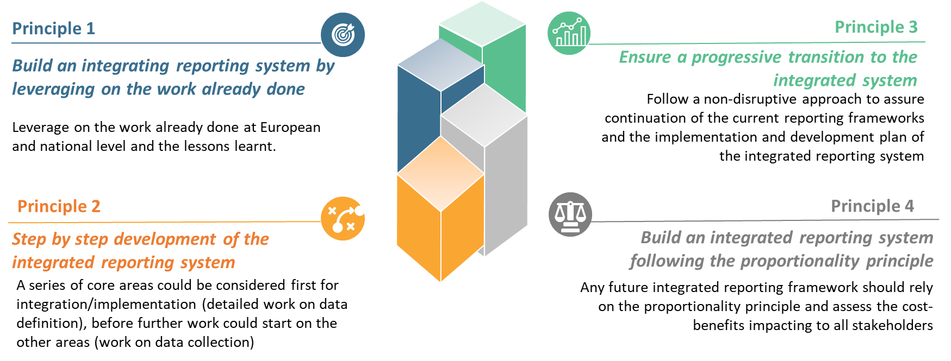
5. Key messages
Developments and decisions on Integrated reporting (collaboration inside the JBRC and with the industry):
Should account for the need of the EBA, together with the national authorities to work and deliver on the mandates and ensure the availability of relevant data for supervisory and resolution tasks
Leverage on work done -> consider the EBA already harmonized data dictionary for supervisory and resolution, the DPM and its evolution to the DPM refit
Consider the principles identified in the EBA feasibility study

Slide 8
Reporting initiatives at EBA and ECB are driven by similar goals
Work under integrated reporting will further ensure operational alignment between the prudential, resolution and statistical reporting processes
reduce the reporting costs for the reporting institutions;
facilitate data sharing and increase coordination among authorities
(following the ‘report once principle’).
streamline and increase the efficiency in the reporting processes
facilitate data comparability, remove overlaps (following the ‘define once’ principle);

Slide 9
Thank you for your attention!
Questions or comments?

