Slide 1
Tax-Loss Harvesting with Cryptocurrencies
2022 EBA Policy Research Workshop
October 2022
Lin William Cong Cornell University & NBER
Daniel Rabetti Tel Aviv University & Cornell Fintech Initiative
Wayne R. Landsman University of North Carolina
Edward L. Maydew University of North Carolina & UNC Tax Center

Slide 2
Crypto boom and the tax wild west
Total Mcap ≈ 1T (>21K assets);
1/3 Americans (18~29) invested in crypto;
Growing need for regulatory oversight;
Concern with tax compliance;
Easy to evade ecosystem;
Complicated framework.
Simple conceptual framework based on the theory of crime;
specific analysis on traders’ responses to changes in tax scrutiny;
general analysis on exchanges’ trading behavior to provide complementary evidence and estimate the size of tax-loss harvesting;
Cong, Landsman, Maydew, and Rabetti
European Bank Authority

Slide 3
Preview
Using a conceptual framework, we predict and find that increased tax scrutiny leads crypto investors to utilize legal tax planning with tax-loss harvesting as an alternative to non-compliance.
In particular, domestic traders increase tax-loss harvesting following the increase in tax scrutiny, and U.S. exchanges exhibit a significantly greater amount of wash trading, especially during harvesting periods (EoY and following price drops).
Additional findings suggest that policy targeted at U.S.-based exchanges results in an outflow of trading to unregulated exchanges.
Finally, a lack of policy coordination in crypto creates demand for innovative products, such as NFTs and DeFi, where tax guidance is particularly lacking.
Cong, Landsman, Maydew, and Rabetti
European Bank Authority

Slide 4
Evolution of tax guidance in the USA
2021
2018-07
2014
2018-03
2019-07
2009
2016
IRS Tax Treatment
IRS First Guidance
IRS Blockchain Forensics
IRS Campaign
Treasury Dept. report to IRS
IRS Letters
Cong, Landsman, Maydew, and Rabetti
European Bank Authority

Slide 5
Theoretical Framework
In our setting, crypto traders are faced with the following decision: report their crypto income to the tax authority, or instead, evade the tax by not reporting, hoping that they remain undetected [faciliated by the unregulated nature of the market].
The model predicts that as domestic crypto traders decrease their tax evasion following changes in tax authority scrutiny, they increase their crypto tax-loss harvesting - especially in harvesting periods.
This prediction is based on the economic theory of crime developed by Becker (1968), later applied to tax evasion by Allingham and Sandmo (1972) and others (Sandmo, 2005; Slemrod, 2007).
Cong, Landsman, Maydew, and Rabetti
European Bank Authority

Slide 6
Empirical Analysis I 500 large retail traders responses to IRS Scrutiny Do domestic traders respond to IRS scrutiny by increasing loss harvesting?
Cong, Landsman, Maydew, and Rabetti
European Bank Authority

Slide 7
Trading Account Data - Retail Traders
Retail Traders Data:
Proprietary data on trading activity of 500 large retail traders (1/4 domestic -> treated, 3/4 international -> control);
Confidentiality regarding traders’ identity;
Domestic traders -> at least 10% of trades in USD;
International trades -> spread across Europe and Middle East;
Trades: >1M trades from 2013 to 2020;
The data includes information on inbound and outbound transfers, cryptocurrency pairs, fees collected, transaction’s size, prices in Bitcoins and U.S. dollars, and the crypto exchange used for each transaction;
Traders became clients in early 2019, receiving assistance in reporting taxable income.
Such traders are likely to be more tax compliant than typical crypto traders, limiting generalizability of findings.
Cong, Landsman, Maydew, and Rabetti
European Bank Authority

Slide 8
Trading Account Dataset
Cong, Landsman, Maydew, and Rabetti
European Bank Authority

Slide 9
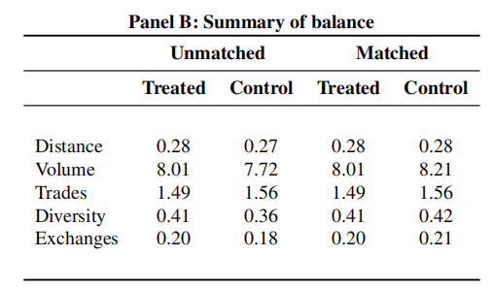
Matching
Cong, Landsman, Maydew, and Rabetti
European Bank Authority

Slide 10
Prediction 1
“Following increases in tax authority scrutiny, domestic crypto traders affected by tax authority scrutiny increase the extent of their tax-loss harvesting”
↑scrutiny → ↑compliance → ↑harvesting
Cong, Landsman, Maydew, and Rabetti
European Bank Authority

Slide 11
Tax-Loss Harvesting: Retail Traders
Cong, Landsman, Maydew, and Rabetti
European Bank Authority

Slide 12
Prediction 2
“Following increases in tax authority scrutiny, domestic traders increase tax-loss harvesting following price declines or toward year-ends.”
↑scrutiny → ↑compliance → ↑↑↑harvesting
(EoY)
Cong, Landsman, Maydew, and Rabetti
European Bank Authority

Slide 13
Trading at the end of the year
Cong, Landsman, Maydew, and Rabetti
European Bank Authority

Slide 14
Do domestic traders respond to IRS scrutiny by increasing loss harvesting? Yes ↑tax-loss harvesting especially, in response to IRS events and harvesting periods (EoY)
Cong, Landsman, Maydew, and Rabetti
European Bank Authority

Slide 15
Empirical analysis II Crypto Exchange Data (Billions of trades ~ 34 Exchanges) Generalization of previous results and Estimate Tax-Loss Harvesting in the United States
Cong, Landsman, Maydew, and Rabetti
European Bank Authority

Slide 16
Data - Crypto Exchanges
Exchange trading data:
trade book data across 34 crypto exchanges;
Focus on BTC (Bitcoin) to USD or USDT (Tether);
Includes domestic exchanges such as Coinbase and Kraken;
Includes large exchanges with domestic presence such as Binance;
Trades: ~3.2 billion trades in the period of 2011 to 2021;
Volume: ~5.2 trillion dollars in the period of 2011 to 2021;
Trading Variables:
each trade is reported in miliseconds, price (~volume), and the direction (buy or sell);
wash trades -> determined whether a sell & buy order occurs in the same pair, same exchange, at the same quantity and price, and within 60 seconds;
variable of interest: the number of wash trades to total trades.
Exchange Variables—measure US exchanges in two ways:
Regulated exchanges -> the exchange is regulated by the New York State Department of Financial Services or by FinCEN (a bureau of the U.S. Department of the Treasury);
Presence: the exchange has presence in the US’ includes regulated ones plus others with offices in the US (and thus are likely to have a large base of U.S. traders).
Cong, Landsman, Maydew, and Rabetti
European Bank Authority

Slide 17
Trading Books (daily)
Cong, Landsman, Maydew, and Rabetti
European Bank Authority

Slide 18
Wash trades endogenous considerations (volume inflation)
Cong, Landsman, Maydew, and Rabetti
European Bank Authority

Slide 19
Wash trades: existing studies
Endogenous considerations: ↑ fake volume = ↑costumers ↑revenue;
Bitwise report
Up to 95% of aggregate volume in Bitcoin is fake;
Cong, Li, Tang and Yang (2021)
develop measures of fake trade (e.g., benford distance);
70% of trading volume on top 3 crypto currencies on unregulated exchanges is fake;
Aloosh and Li (2021)
up to 33% of volume in Bitcoin on Mt. Gox exchange is fake;
A “smoking gun” evidence of fake trading;
Amiram, Lyandres, and Rabetti (2021)
mean fake trade in the market is about 20%;
develop measures of fake trade (e.g., EDM algorithm);
focus on competition among crypto exchanges;
short term benefits to long term reputational costs trade off.
Cong, Landsman, Maydew, and Rabetti
Cong, Landsman, Maydew, and Rabetti
European Bank Authority

Slide 20
Potential harvesting period (BTC ↓)
~70% price decline
potential harvesting period
Cong, Landsman, Maydew, and Rabetti
European Bank Authority

Slide 21
Tax-Loss Harvesting Evidence: BTC ↓
Exogenous Wash Trade ≈ Tax-Loss Harvesting
Endogenous Wash Trade ≈ Volume Inflation
Cong, Landsman, Maydew, and Rabetti
European Bank Authority

Slide 22
Evidence of wash trading consistent with loss harvesting especially for: (i) high liquid pairs (↓vol inflation) (ii) regulated exchanges (↓vol inflation) (iii) harvesting periods (↓vol inflation)
Cong, Landsman, Maydew, and Rabetti
European Bank Authority

Slide 23
Applications (1) Generalize our previous results (2) Estimate the size of TLH in the USA
Cong, Landsman, Maydew, and Rabetti
European Bank Authority

Slide 24
Corollary 1
C1: Following increases in tax scrutiny, domestic exchanges experience greater tax-loss harvesting than international exchanges.
↑scrutiny → ↑wash trade→ ↑harvesting
Cong, Landsman, Maydew, and Rabetti
European Bank Authority

Slide 25
Cong, Landsman, Maydew, and Rabetti
European Bank Authority

Slide 26
Corollary 2
C2: Following increases in tax authority scrutiny, domestic exchanges experience greater tax-loss harvesting, especially following periods of price decline and toward year-ends.
↑scrutiny → ↑wash trade → ↑↑↑harvesting (during harvesting periods)
Cong, Landsman, Maydew, and Rabetti
European Bank Authority

Slide 27
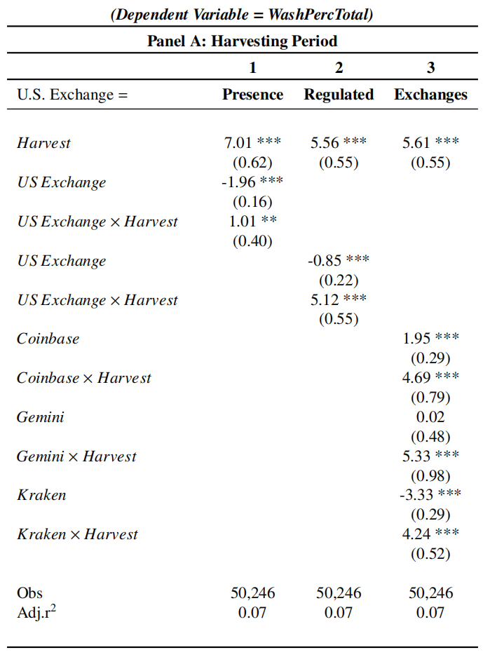
Tax-Loss Harvesting at EOY following large price decline
Cong, Landsman, Maydew, and Rabetti
European Bank Authority

Slide 28
Applications (1) Generalize our previous results (2) Estimate the size of TLH in the USA
Cong, Landsman, Maydew, and Rabetti
European Bank Authority

Slide 29
(2) Estimating Tax-Loss Harvesting Revenue
wash trading (harvesting period)
difference
wash trading (median)
Cong, Landsman, Maydew, and Rabetti
European Bank Authority

Slide 30
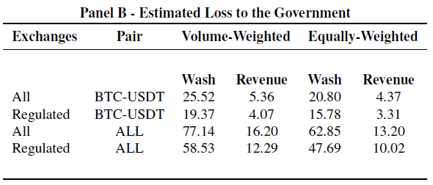
(2) Estimated Tax-Loss Harvesting Revenue
In 2018, federal capital gains tax revenue was $158.4 billion -> Potential: Increase of about 5-10% tax revenue [only BTC].
.
Cong, Landsman, Maydew, and Rabetti
European Bank Authority

Slide 31
Extended Discussion
and Policy Coordination
Cong, Landsman, Maydew, and Rabetti
European Bank Authority

Slide 32
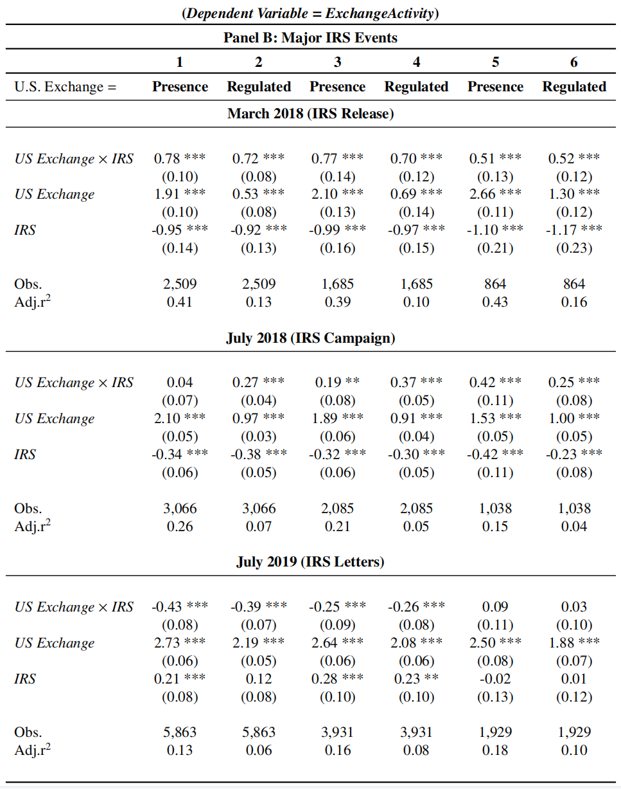
Effects of Tax Scrutiny on Traders’ Exchange Preferences
guidance
guidance
privacy
Cong, Landsman, Maydew, and Rabetti
European Bank Authority

Slide 33
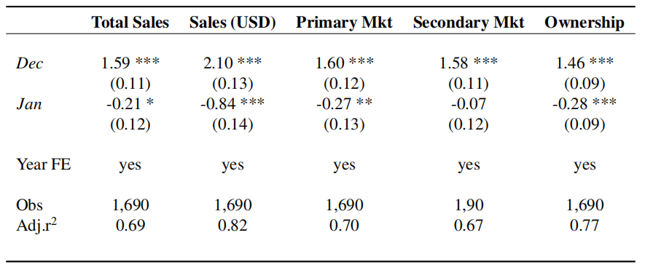
Gray Areas of Taxation: Non-Fungible Tokens (NFTs)
Cong, Landsman, Maydew, and Rabetti
European Bank Authority

Slide 34
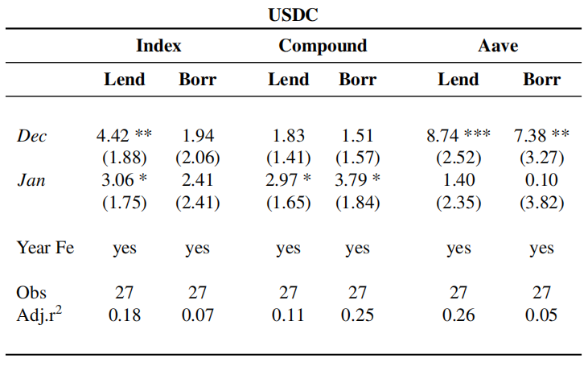
Gray Areas of Taxation: Decentralized Finance (DeFi)
Cong, Landsman, Maydew, and Rabetti
European Bank Authority

Slide 35
The Relevance of Policy Coordination
→ The IRS passed a resolution in 2014 treating trading of cryptocurrencies as trading on a property (Crypto → Property);
→ CFTC considers crypto as a subject to the provisions of the Commodity Exchange Act and CFTC Regulations (Crypto → Commodity).
→ The SEC Chairman, Gary Gensler, has argued that investor protection rules similar to those that cover derivatives and equities should apply to crypto exchanges (Crypto → Security);
→ FASB's recent release states that accountants should adopt fair-value accounting instead of treating holdings as intangibles (Crypto → Financial Assets);
→ A bipartisan group of seven congressmen led by Rep. Tom Emmer introduced a bill seeking for Congress to provide a clear definition of digital assets under U.S. securities law.
Cong, Landsman, Maydew, and Rabetti
European Bank Authority

Slide 36
Summary
→ We describe the landscape of taxation in the crypto markets concerning U.S. taxpayers, and examine how recent increases in tax scrutiny have led to changes in trading behavior by crypto traders;
→ Building on the conceptual framework of Becker (1968) and Allingham and Sandmo (1972), we predict and find that increased tax scrutiny leads crypto investors to utilize legal tax planning with tax-loss harvesting as an alternative to non-compliance;
→ However, we also find that transactions in NFTs as well as the lending rate in DeFi lending peak toward year-ends, which is consistent with the seasonality of tax considerations;
→ Accounting research on blockchain and cryptocurrencies is a nascent but vibrant field, offering valuable insights to market players and regulators. Understanding investors’ responses to policy changes in crypto taxation, as well as describing patterns and trends are just the first steps.
Cong, Landsman, Maydew, and Rabetti
European Bank Authority

Slide 37
Thank you! Daniel Rabetti rabetti@mail.tau.ac.il
Cong, Landsman, Maydew, and Rabetti
European Bank Authority

