Slide 1
Update on supervisory disclosure
Amparo Miró, Statistician
SGAT SUP Meeting | 09 December 2022

Slide 2
Update on supervisory disclosure
Feedback received during consultation addressed to CAs
The draft CP was circulated to SGAT and SGSDI for comments.
10 responses were received > The package was supported
Most of the responses were integrated, while some proposals would need further discussions with CAs before being integrated.
In addition, several CAs suggested removing options and discretions which have expired. In this respect, EBA approach is to keep such provisions. However, for each provision that has expired, it will be added a footnote/disclaimer in the ITS clearly stating that the application of the relevant provision has now expired and thus the information on the exercise of the discretion covers historically only the period up to the expiration date.
On case-by-case options and discretions, it was agreed that they would not be included in the ITS. Therefore, the proposals related to discretions which may be granted to specific institutions have not been included at this stage.

Slide 3
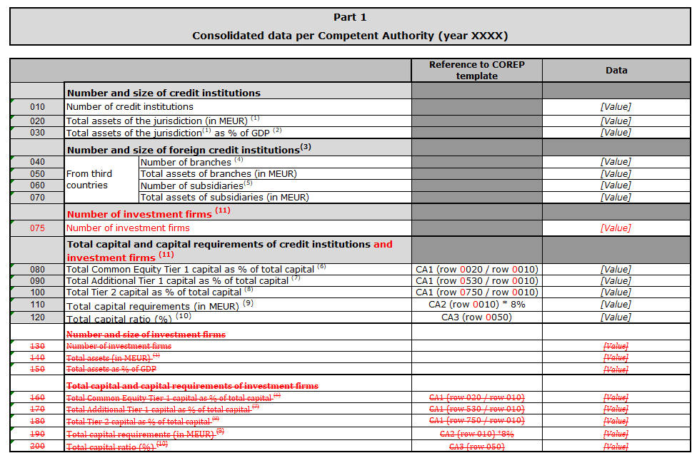
Update on supervisory disclosure (II)
In Annex IV, it is proposed now to cover now class one minus MiFID investment firms that are subject to CRR/CRD and would be subject to this ITS rather than the equivalent under IFR/IFD. In order to reduce the reporting burden and to ensure the confidentiality, it is proposed to report it aggregated together with the information of credit institutions where applicable.

Slide 4
Update on supervisory disclosure (III)
In the last step of the process is expected to adjust the row numbers and the footnotes to reflect the deletion of rows.
Next steps
The draft Consultation Paper will be sent to SCRePol and SCREDAT for review and approval during the first half of December.
The draft CP will be submitted in a written procedure to the EBA BoS for comments and agreement on its subsequent publication subject to SC members agreement.

Slide 5
Thank you.
If you have a question,
please raise your hand
or use chat.
???
?
!

