Slide 1
EBA FinTech Knowledge Hub series: Webinar on the impact of FinTech on incumbent credit institutions’ business models
Thursday, 11 October 2018
Presenters: Slavka Eley, Andreas Papaetis, Achilleas Nicolaou

Slide 2
Contents
1
EBA focus on FinTech
2
Profitability landscape in the EU banking sector
3
Key findings of the EBA thematic report

Slide 3
1
EBA focus on FinTech

Slide 4
EBA priorities on FinTech
Taking account the feedback to the EBA's 2017 Discussion Paper on FinTech, and the new mandates for the EBA set out in the European Commission's FinTech Action Plan, the EBA has published on 15th March 2018 its FinTech Roadmap setting out its priorities for 2018/2019 along with an indicative timeline for the completion of these tasks. These priorities are:
monitoring the regulatory perimeter, including assessing current authorisation and licencing approaches to FinTech firms, and analysing regulatory sandboxes and innovation hubs in order to identify a set of best practices to enhance consistency and facilitate supervisory coordination;
monitoring emerging trends and analysing the impact on incumbent institutions' business models and the prudential risks and opportunities arising from the use of FinTech in order to enhance knowledge sharing;
promoting best supervisory practices on assessing cybersecurity and promoting a common cyber threat testing framework;
addressing consumer issues arising from FinTech, in particular in the areas of unclear regulatory status of FinTech firms and related disclosure to consumers, potential national barriers preventing FinTech firms from scaling up services to consumers across the single market, and assessing the appropriateness of the current regulatory framework for virtual currencies;
identifying and assessing money laundering/terrorist financing risks associated with regulated FinTech firms, technology providers and FinTech solutions.

Slide 5
EBA FinTech Roadmap
Authorisation and Perimeter Issues
Regulatory sandboxes and innovation hubs
Impact on business models, prudential risks and opportunities
Cybersecurity
Consumer and Conduct Issues
AML/CFT
EBA FinTech Knowledge Hub

Slide 6
EBA work to date
2017
Report on Innovative uses of data
Recommendations on outsourcing to cloud service providers
2018
Consultation Paper on Guidelines on outsourcing arrangements
Report on the impact of FinTech on incumbent credit institutions' business models
Report on the prudential risks and opportunities arising for institutions from FinTech
Opinion on the implementation of the RTS on strong customer authentication and common and secure communication
ESAs report on Big Data
Joint ESAs Warning on Virtual Currencies
Joint ESAs Opinion on the use of innovative solutions in the customer due diligence processes

Slide 7
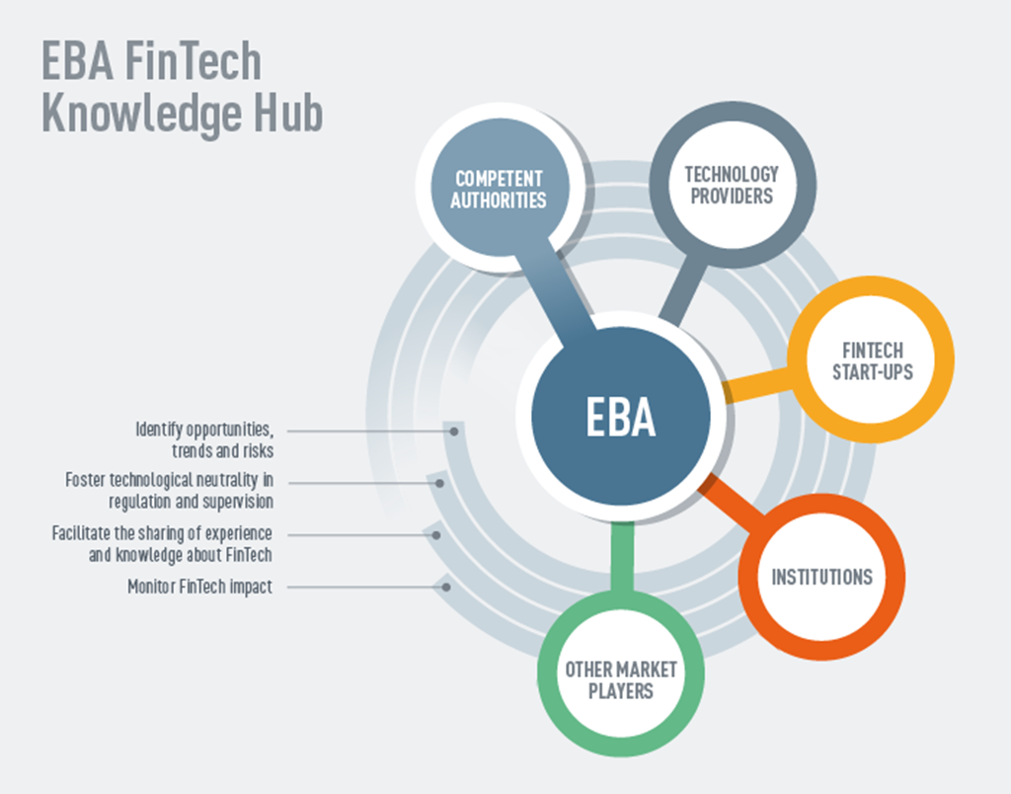
EBA FinTech Knowledge Hub
You are invited to register to the EBA FinTech Hub: https://www.eba.europa.eu/financial-innovation-and-fintech/fintech-knowledge-hub/stakeholder-register/registration-form

Slide 8
2
Profitability landscape in the EU banking sector

Slide 9
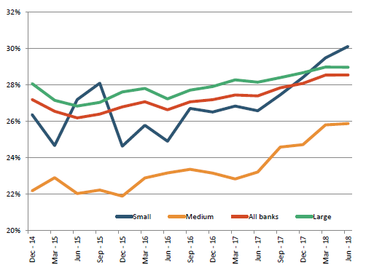
Banks’ profitability improved compared to previous years
RoE at 7.2% in Q2 2018 is stable y-o-y, but up from 6% in Q4 2017. However, it is still below banks’ CoE (9-10%). Dispersion across banks is at its lowest point.
Main drivers of profitability in H1 2018 were: 1) lower cost of risk and 2) higher fee and commission income. Q2 2018 trends show a significant decrease of trading income y-o-y (one of the main drivers of RoE in 2017).
Net fee and commission income to total operating income increased for 4 consecutive quarters, at 28.6% (highest since Dec-14). Increase across all size of banks, but more evident in small size
RoE developments
Net Fee and Commission income to total operating income
Source of all charts: (preliminary) RDB data Q2 2018.

Slide 10
but there is pressure on margins…and continuing pressure on efficiency
Banks core earnings (Net Interest Income) are further decreasing. Net Interest Margin has reached a record low at 1.43% in Q2 2018.
There are no signs of improving efficiency. In Q2 2018 costs to income ratio remained stable (y-o-y) at 63.8%.
NII and Net Interest Margin Developments
Efficiency development (Cost-to-income ratio)
Source of all charts: (preliminary) RDB data Q2 2018.

Slide 11
Increased importance on net fees and commission to increase profitability
Results of EBA RAQ July 2018, confirm drivers of profitability as net fees and commission income become increasingly important for banks, as they target this income stream in order to increase profitability in the short term.
Q: What is your primary target for increasing profitability in the next 12 months?

Slide 12
But also cost reduction is an important factor
Also cost reduction plays a significant role in banks’ targets for increasing profitability in the near future.
Banks attempt to increase profitability by reducing overheads but also by heavily investing in digitalisation.
All banks participating in the EBA RAQ of July 2018, have stated their plans to reduce operating expenses and costs through increasing automation and digitalisation.
In the short-term, this comes with a cost in investing heavily in IT infrastructures and increasing investments related to Financial Technology.
Q: How are you reducing operating expenses/costs?

Slide 13
3
Key findings of the EBA thematic report

Slide 14
EBA thematic report on the impact of FinTech on incumbent credit institutions’ business models
In July 2018, the EBA has released a thematic report on the impact of FinTech on incumbent credit institutions’ business models, presenting its current observations and findings on the current (without foreseeing or intending to model scenarios for potential future development).
This report is based on the following different sources of information, collected within the broader activities of the EBA FinTech Knowledge Hub:
Industry feedback to the EBA’s Discussion Paper on FinTech
Discussions/interviews with a sample of credit institutions
EBA Risk Assessment Questionnaire (RAR)
Discussions/interviews with competent authorities
Desk research

Slide 15
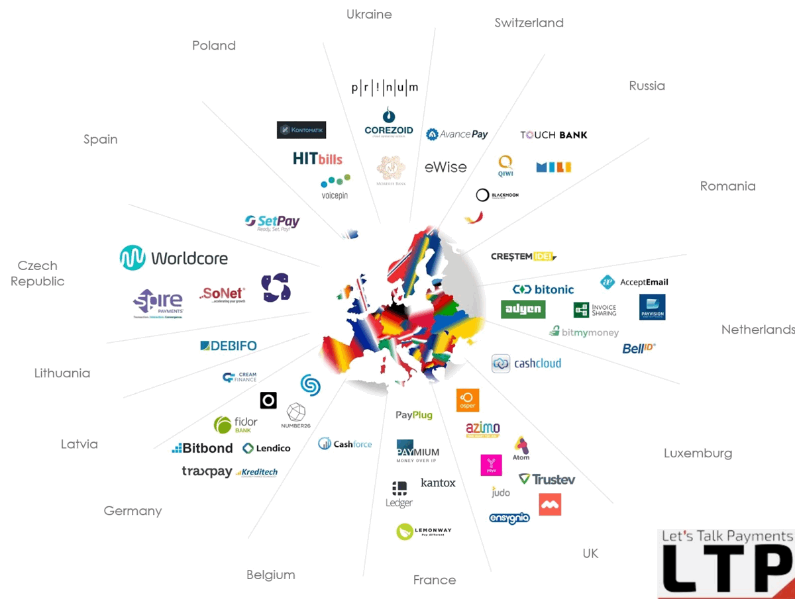
Key drivers inducing changes in incumbents’ business models
1
Heightened competition
2
Customer expectations and behaviour:
*Source: VISA
3
Profitability concerns
4
Regulatory changes

Slide 16
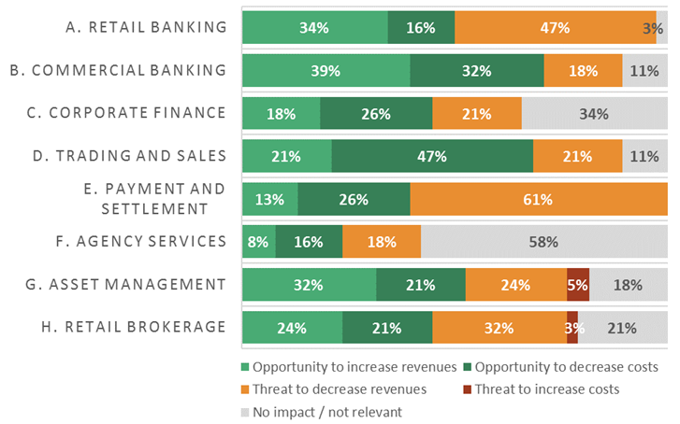
Which business line is mostly affected?
Q: Impact of FinTech firms on banks’ current business lines
Source: EBA RAR H2 2017

Slide 17
Key trends in reacting to FinTech
Employing new technologies to transform internal processes – “digital transformation” component
Rethinking interaction with customers / enhancing customer experience through the use of innovative technologies – “digital disruption” component
1
2
Digital disruption
Digital transformation

Slide 18
Status of adoption of financial technologies by incumbents
Source: EBA RAQ H2 2018 (preliminary results)
Open Banking / APIs
PSD2 is perceived as an opportunity with most institutions currently designing their open banking/API strategy
Relevant RTS is directly applicable from 14 September 2018

Slide 19
Current relationship of incumbents with FinTech
Partnering
with new entrant FinTech
firms
Developing internally
Investing
in new entrant FinTech firms
Collaborating
with other stakeholders

Slide 20
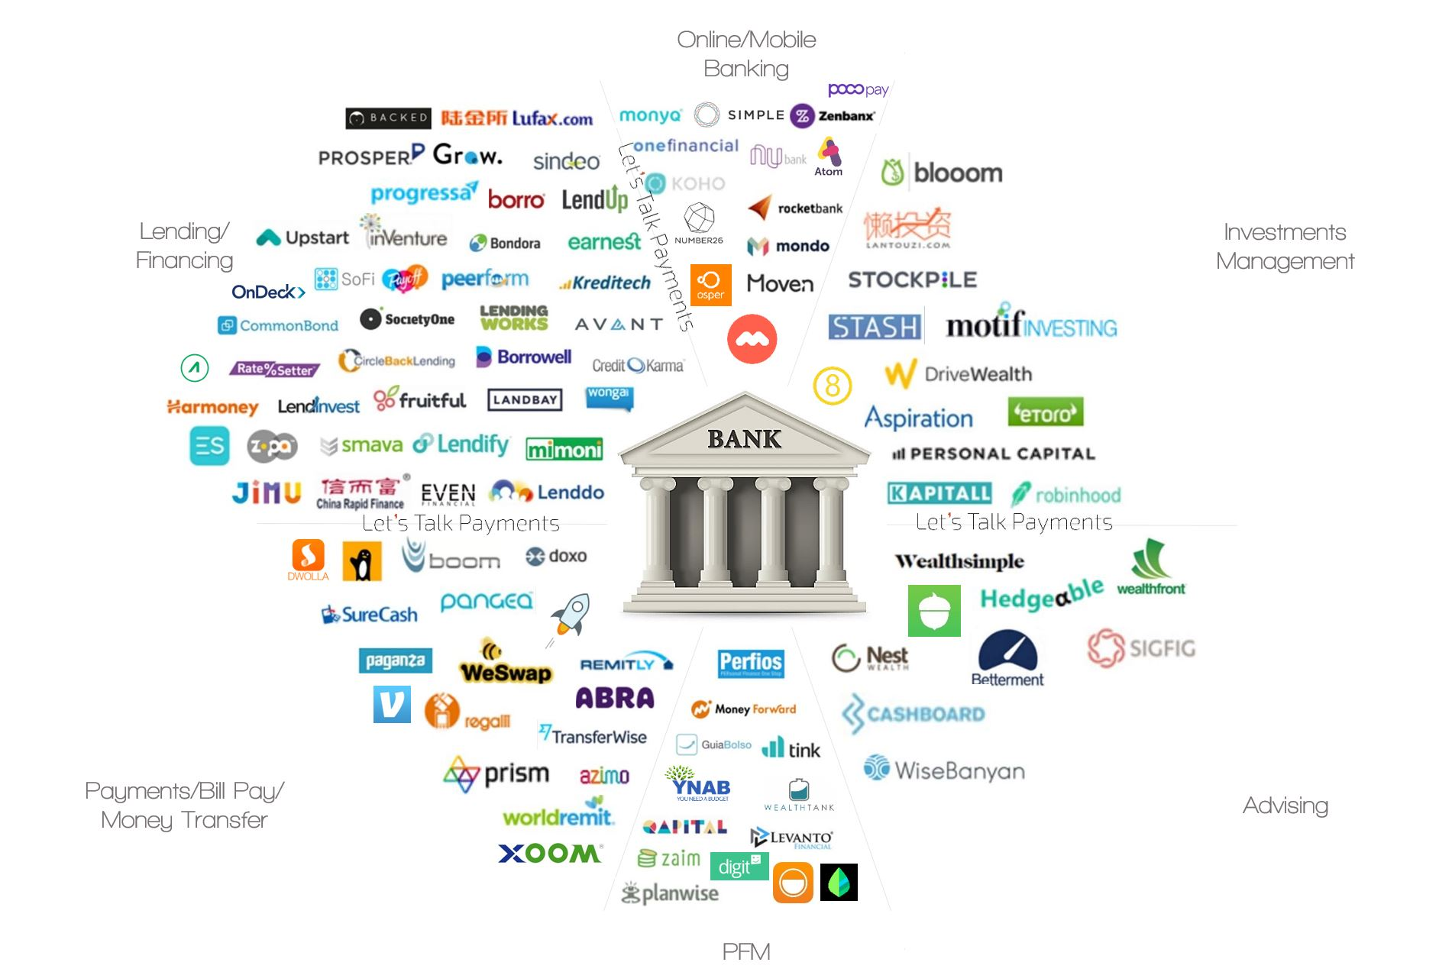
Current status: Incumbents favour partnerships with FinTech firms
Institutions
New entrant FinTech firms
Issue with existing IT infrastructure / IT legacy systems
Need to develop internal “innovative” culture and mindset / organisational transformation
Need to attract and maintain talent and skills
Customers trust banks compared to new entrants (mainly due to data protection concerns)
Strong on customer relationship providing the full value chain to customers with respective customer expectations and behaviour
Agile, flexible and familiar with technologies
Learn and grow through partnerships with banks
Through their interaction with banks, they receive funding, access to customers and distribution channels, visibility, and banking expertise (including legal, compliance and regulatory knowledge)
Do not currently provide the full value chain to customers
Partnering

Slide 21
Risk factors impacting business models’ sustainability
DIGITALISATION STATEGIES
1
LEGACY ICT SYSTEMS
2
EXECUTION CAPABILITIES
3
ACCESS AND MAINTENANCE OF TALENT
4
COMPETITION
5

Slide 22
Status of FinTech adoption and engagement
In terms of the level of adoption of innovative technologies, engagement with FinTech, current digitalisation/innovation strategies, along with the respective stage of development, incumbent institutions seem to fall into three groups:
PROACTIVE
Proactive/ Front-runners
Ambitious or aggressive innovation strategies, high-targeted transformation projects accompanied unclear impact and risk assessments (aiming for first-mover advantage)
Well-thought and comprehensive strategies and targets with strong research orientation and focus on governance, organisational aspects, operations and risk management
REACTIVE
Reactive
‘Followers’ of technological developments, taking a ‘wait and see’ approach, with carefully defined strategies and steady-pace on internal changes
Institutions reacting to peer pressure, taking a ‘go with the flow’ approach in combination with the concern of staying behind.
PASSIVE
Passive
Lagging behind technological developments due to other significant priorities, slowly trying to catch up following customer changing expectations
Conservative/more traditional institutions reluctant to change

Slide 23
EBA FinTech contact details
Website: www.eba.europa.eu/financial-innovation-and-fintech
Email: fintech@eba.europa.eu
Register here for the FinTech Knowledge Hub: www.eba.europa.eu/financial-innovation-and-fintech/fintech-knowledge-hub/stakeholder-register

