Slide 1
Leveraged Loans: Is High Leverage Risk Priced in? Newton D. P., Ongena S., Xie R., Zhao B.
EBA Policy Research Workshop
Paris | 26-27 October 2022
Simone Casellina

Slide 2
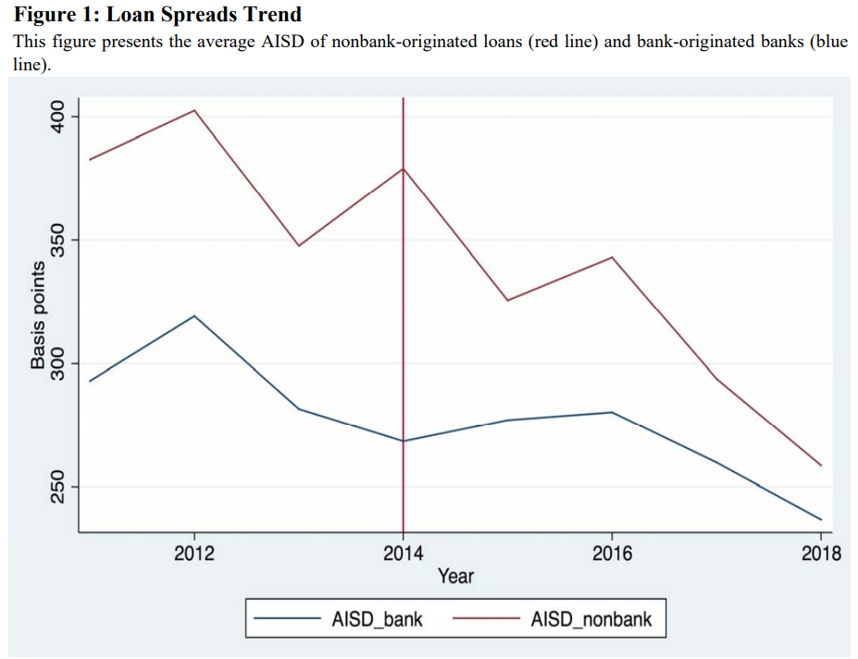
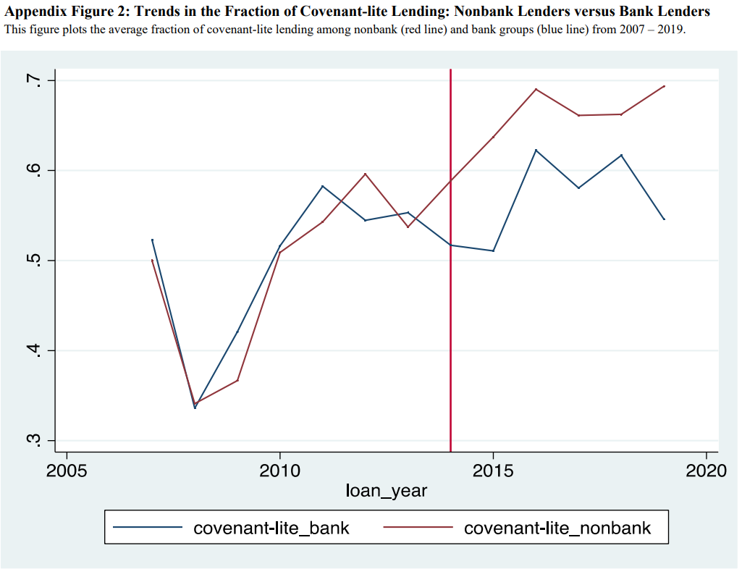
Main contents of the paper
Typical problem for IA in banking regulation: rules enter into force at the same time for all the subjects
The paper exploits the issuance of Guidance and the related Clarification on leveraged loans by the FDIC and the fact that this rule does not apply to all the market participants.

Slide 3
Main contents of the paper

Slide 4
Main contents of the paper

Slide 5
Main contents of the paper
Accuracy?

Slide 6
Main contents of the paper

Slide 7
Q1: Pricing
Is High Leverage Risk Priced in?
is adequate gives the risk?
by focusing on the paper provides evidence about the presence of opportunistic behaviours of shadow banks
it would be interesting to study the adequacy of with respect of
Is data on realised losses (default rates and loss rates) available?
2020 STUDY Requested by the ECON committee (cfr slide 9)
→ EL
→ UL

Slide 8
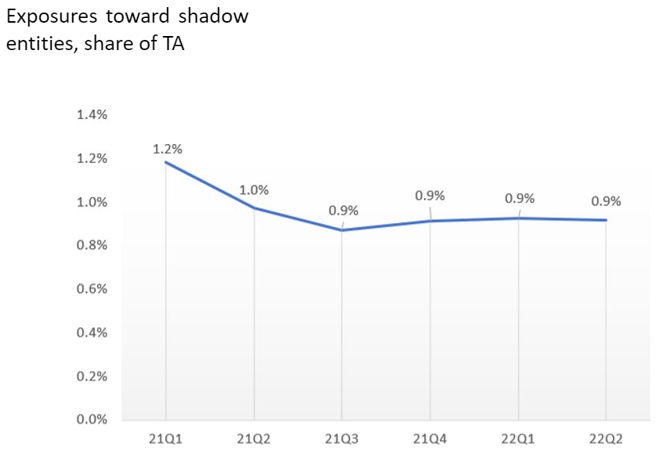
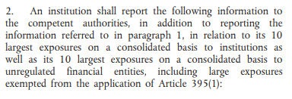
Q2: Do we have data on Shadow banking?

Slide 9
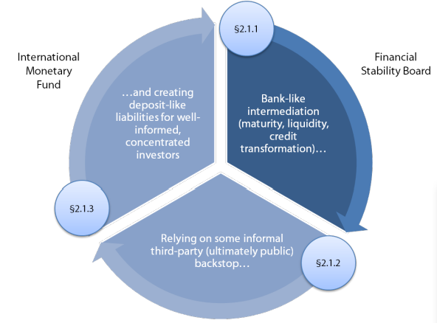
Q3: Do we have a shared definition of Shadow Banking?
The expression Shadow banking System was introduced by P. Mc Culley: Teton Reflections – 2007. Jackson Hole Economic Symposium
Shadow Banking: what kind of Macroprudential Regulation Framework? 2020 STUDY Requested by the ECON committee
<<In order to give an effective meaning to a notion and not merely an appearance of such in a metaphysical/verbalistic sense, an operational definition is required. By this we mean a definition based on criteria that allows us to measure it. In other words, the definition should allow an observable individual to take an observable decision.>>.
de Finetti, 1973 Theory of Probability, pag 70.

Slide 10
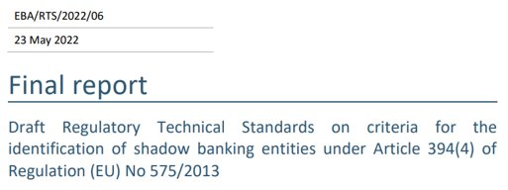
Q3: Do we have a shared definition of Shadow Banking?

Slide 11
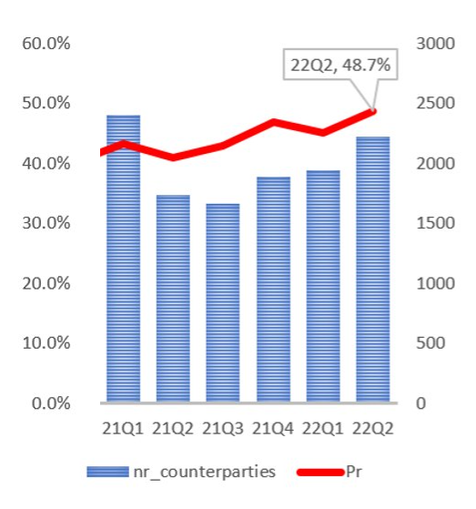
Q3: Do we have a shared definition of Shadow Banking?
allow an observable individual to take an observable decision

