Slide 1
Cyberattacks on Small Banks and the Impact on Local Banking Markets
Fabian Gogolin (University of Leeds)¹, Ivan Lim (Durham University)² & Francesco Vallascas (Durham University)³
¹e-mail: f.gogolin@leeds.ac.uk
²e-mail: ivan.lim@durham.ac.uk
³e-mail: francesco.vallascas@durham.ac.uk

Slide 2
Background and Research Questions
Cybersecurity is a growing concern for bankers & regulators: FDIC Chairman Jelena McWilliams states that “[c]ybersecurity is the biggest threat facing America’s banks”.
Fast-growing technological content of banking products: more frequent & sophisticated attacks in the financial industry than in other industries (financial firms are 300 times more likely to become targets of cyberattacks than other firms, Boston Consulting Group).
Cyberattacks costly for banks?

Slide 3
Background and Research Questions
Our questions:
How do small bank depositors/customers react to cyberattacks? Which implications for local banking markets?
Our study assesses:
Direct effects (i.e., the impact of cyberattacks on hacked small banks);
Indirect (spillover) effects (i.e., the implications for other banks and for the structure of the local market).
Jointly, through the analysis of these effects we offer indications on the where deposits flow after a cyberattack and the consequent impact on local banking markets in terms of: a) market structure; b) small business lending.

Slide 4
Why Small Banks?
Our perspective: Cybersecurity problems as a competitive threat for small banks.
Nationwide indicates that almost half of cybercrimes between 2012-2017 target US banks with assets below $1billion.
70% of community bankers rank Cybersecurity as their top concern (Conference of State Bank Supervisors, 2019).
Cybersecurity investment gaps between large and small banks: Analogy between cybersecurity investment gaps between small and large banks and innovation gaps between rival firms in theoretical models on the consequences of (lack of) innovation (see Bloom et al., 2013; Klette and Kortum, 2004).

Slide 5
Why Small Banks?
The average yearly cybersecurity investment by US banks has surpassed 10% of their IT budget - Deloitte, 2019).
“The largest financial institutions devote tremendous resources to addressing cyber risks……. But regional and community financial institutions do not have those resources or capabilities. Like those in many other sectors, they may often have limited in- house cyber expertise, do not have the reach to work directly with the federal government, and have limited budgets to devote to cybersecurity” (Samir Jain, Director of Policy, Center for Democracy and Technology, HFSC Cyber Security Hearing, November 2021)
Broad consequences for the role of small banks?

Slide 6
Relevant Literature
Effects of cyberattacks on corporations: reputational damages (Kamiya et al., 2020), decreased profitability (Akey et al., 2021) and higher audit fees (Li et al., 2020; Rosati et al., 2019).
Cyber risks in banking: key peculiarities with respect to other operational risks (Mester et al., 2019). Systemic implications (Eisenbach et al., 2021; Kotidis and Schreft, 2022); Costs of cyber risks (see, for instance, Aldasoro et al, 2020; Bouveret, 2019).
Negative information on banks and depositor behaviour: negative non-financial information (Chen et al., 2019; Homanen, 2018).
Determinants of small bank decline: overall consolidation of US banking markets (see Berger and Black (2019) for an overview); technological developments has increased scale economies (Berger, 2003; Berger and Mester, 1997; Hughes and Mester, 2013; Wheelock and Wilson, 2012).

Slide 7
Data and Sample
Privacy Rights Clearinghouse database (conventional choice in the cyber risk literature): 2005-2017.
Focus on plausibly “exogenous hacks”. External cybersecurity breaches (not leaks by bank employees):
Customer personal information lost by hacking/malware electronic entry.
“Location”/reporting date of hack.
Small U.S. banks (Fed definition): <$10bln assets & size-geographic matching approach between hacked banks and control banks.
Bank accounting data from call report, deposit data from SoD (FDIC), county data primarily from Bureau of Economics Analysis (BEA).

Slide 8
Methodology: Direct Effects
“Stacked” Cohort Difference-in-Difference.
Event window -3;+3 years around the hack, so additional tests with much shorter windows (i.e., -1;+1).
Baselines Specification (based on branch deposit data):
Ln(Deposits)_{i,j,z,c,t} = α + β₁Treated_{i,j,z,c} x Post_{z,c,t} + Branch FE + County-Year FE + ε_{i,j,z,c,t}
i=branch, j=bank, z=county, c=cohort & t=year

Slide 9
Methodology: Direct Effects
Control group:
Geography: Branches of unaffected banks that reside in the same county as branches of hacked banks and located in the state where the hacked has been disclosed.
Fundamentals: Size bins matching (this appears sufficient to reduce bank heterogeneity – we observe that the ex ante probability to be hacked seems to be the same across the two groups of banks).
Similar pre-hack characteristics, parallel trends, different fixed-effects and aggregation.
Key results hold if we only focus on the county of the hack to further reduce the potential impact of omitted variables.

Slide 10
Methodology: Indirect Effects
We compare different geographic branches of untreated banks: evolution of deposits of branches of unaffected banks in the county where treated small banks operate with the evolution of the deposits of branches of the same banks in adjacent counties where hacked banks are not present.
Focus on branches in different geographies of the same banks should reduce the impact of unobserved bank heterogeneity on our results.
Focus only on adjacent counties should reduce the impact of demand factors that are difficult to fully capture.
We do this test separately for large and small untreated banks.

Slide 11
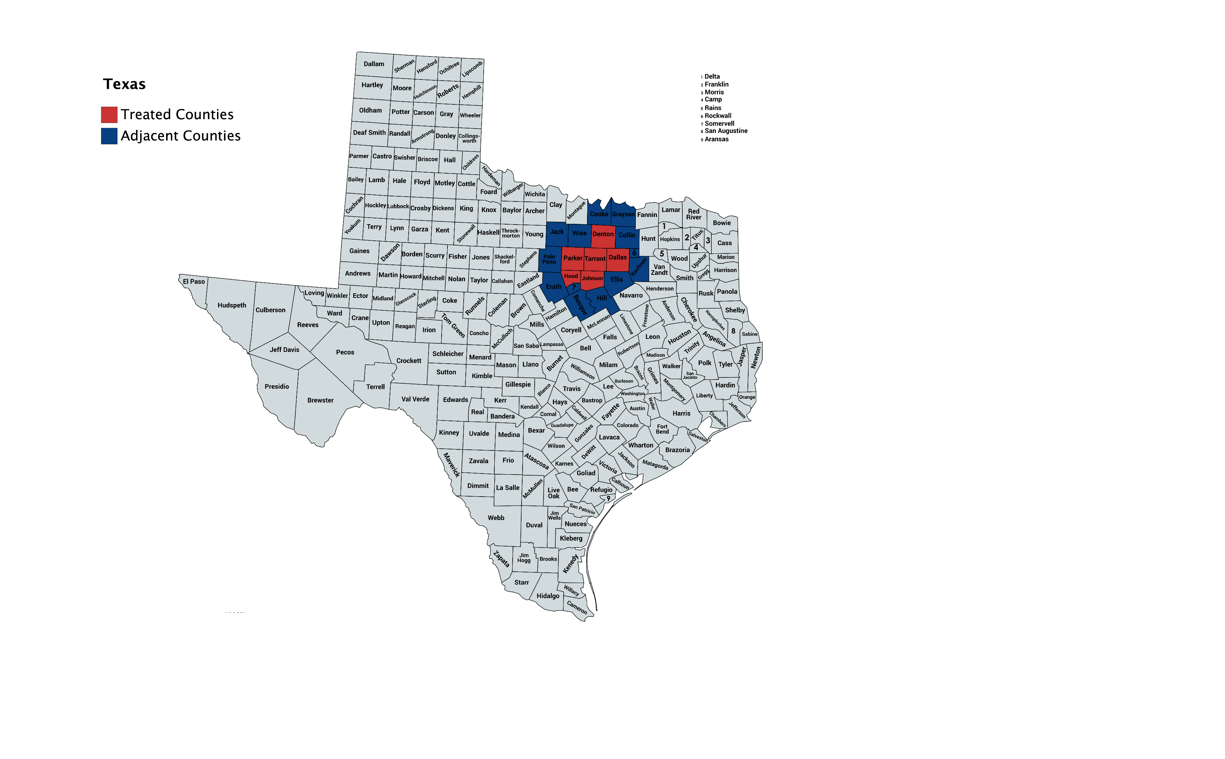
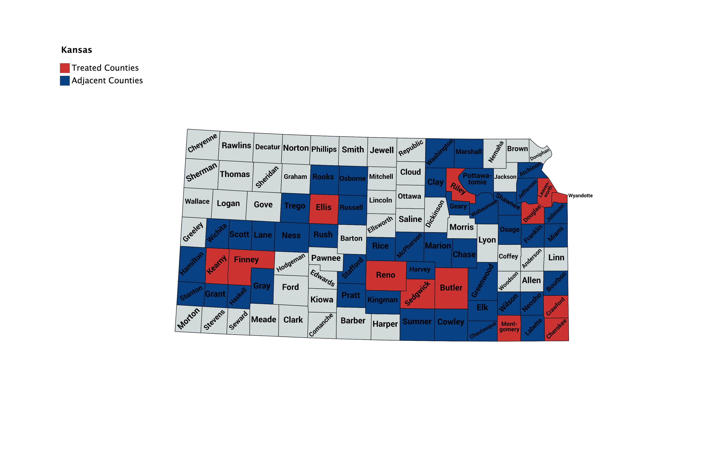
Indirect Effects: An Example
OmniAmerican Bank

Slide 12
Direct Effects

Slide 13
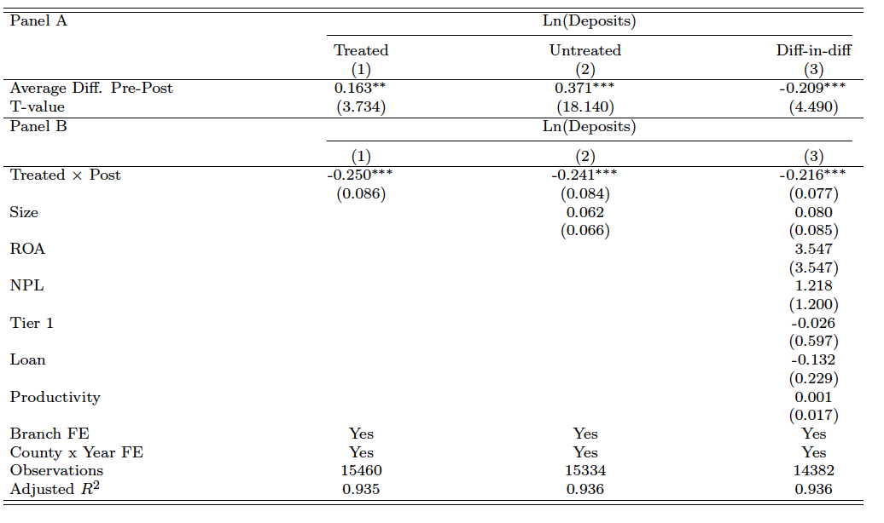
Key Findings
Relatively lower branch deposit growth rates (~20%) in branches of hacked banks after cyberattacks as compared to the control group. Our main result holds across numerous alternative tests (including when we employ an alternative and tighter matching strategy).

Slide 14
Do our findings hold for large banks?
Ex ante unclear:
Concerns over private information loss can lead to slow down in deposit growth if depositors have the possibility to find other banking firms in the market that are perceived as preferable in terms of cybersecurity.
Large banks do not suffer from investment constraints in cybersecurity as small banks, they might still be perceived as the best option available in the market by depositors.
To understand the impact on large banks, we replicate our approach on a sample of cyberattacks involving large banks (banks with >$10bln assets). Size-geographic matching.

Slide 15
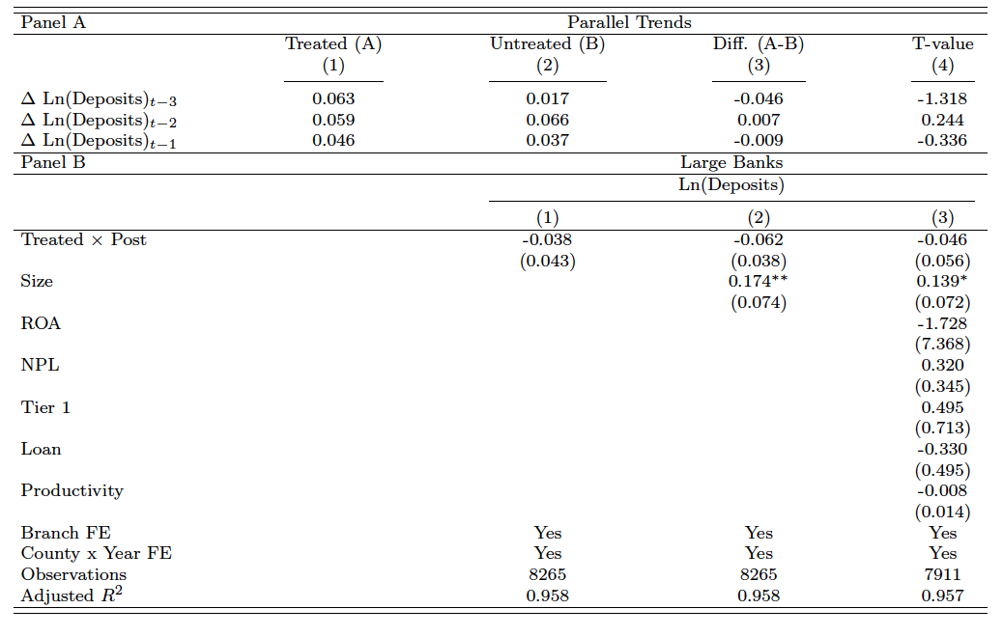
Do our findings hold for large banks?

Slide 16
Why Are Depositors Concerned About Cybersecurity ?
Private information concerns: loss of trust in the technological infrastructure of the small bank and its capacity to protect confidential data.
Savings protection concerns: loss of trust in the ability of the bank to protect savings due to stability concerns linked to the cost effects of these attacks and the remediation processes.

Slide 17
Why Are Depositors Concerned About Cybersecurity ?
We present three tests to understand what explains our results:
Deposit market characteristics: our results are stronger in markets where depositors are expected to be more exposed to identity theft or less digitally sophisticated.
Bank characteristics: our results do not vary with bank risk.
Relationships in the mortgage market: negative consequences for hacked banks also in the mortgage market where households (plausibly) are not much exposed to funding losses but are still exposed to the risk of private information loss.
On average, similar # of loan applications submitted to hacked banks.
However, these applicants tend to be riskier (higher loan-to-income).
Approved loans also riskier.
Conclusion: the first explanation seems to drive our results.

Slide 18
Indirect Effects from Cyberattacks to Small Banks

Slide 19
Indirect Effects to Large Banks: Summary
Positive Spillovers detected: Increase in deposits flow towards branches of larger banks in the hacked local markets .
The positive spillovers are mostly driven by large banks with stronger reputation among customers (measured using survey data).
However, this is not due to the systemic importance of the banks.
Consistent with direct effects, we find a “flight-to-reputation-effect” rather than a “flight-to-stability-effect”.

Slide 20
Indirect Effects to Small Banks: Summary
No general spillover effects in the sample of small banks.
However, some evidence of negative spillovers (contagion) for small banks that share more local market overlaps with the hacked banks.
Market overlaps defined at the ZIP code level.
Local nature of contagion in the banking industry (Iyer and Puri 2012; Pino and Sharma, 2019).

Slide 21
Aggregate Effects
In the last part of our study, we ask the following: Which consequences the direct and indirect effects produce in the local market?
We examine two types of effects:
Analyses on the implications on the market structure: Do large banks gain market shares after cyberattacks to small banks?
Spillover analyses based on the aggregate market share of large banks.
If yes, do we observe any consequences on the provision of small business lending?
We use CRA data for the period under investigation to construct small business lending county data.

Slide 22
Aggregate Effects: Key Findings
Growing importance of large banks in local deposit markets (the aggregate market share of large banks increases post successful cyberattacks on small banks).
Some evidence of relative decline in the growth of small business lending.
The decline, however, is confined to very small loans. To some extent, this is consistent with differences in lending technologies between small and large banks.

Slide 23
Conclusions
Our study documents negative business consequences for small banks after cyberattacks and broad market-wide effects.
Broad effects on market structure: cybersecurity as a competitive edge.
Effects in terms of small business lending (but primarily for very small borrowers).
Implications: Importance of cybersecurity initiatives and investments at the bank and sector level that can enhance cybersecurity in small banking firms.

