Slide 1
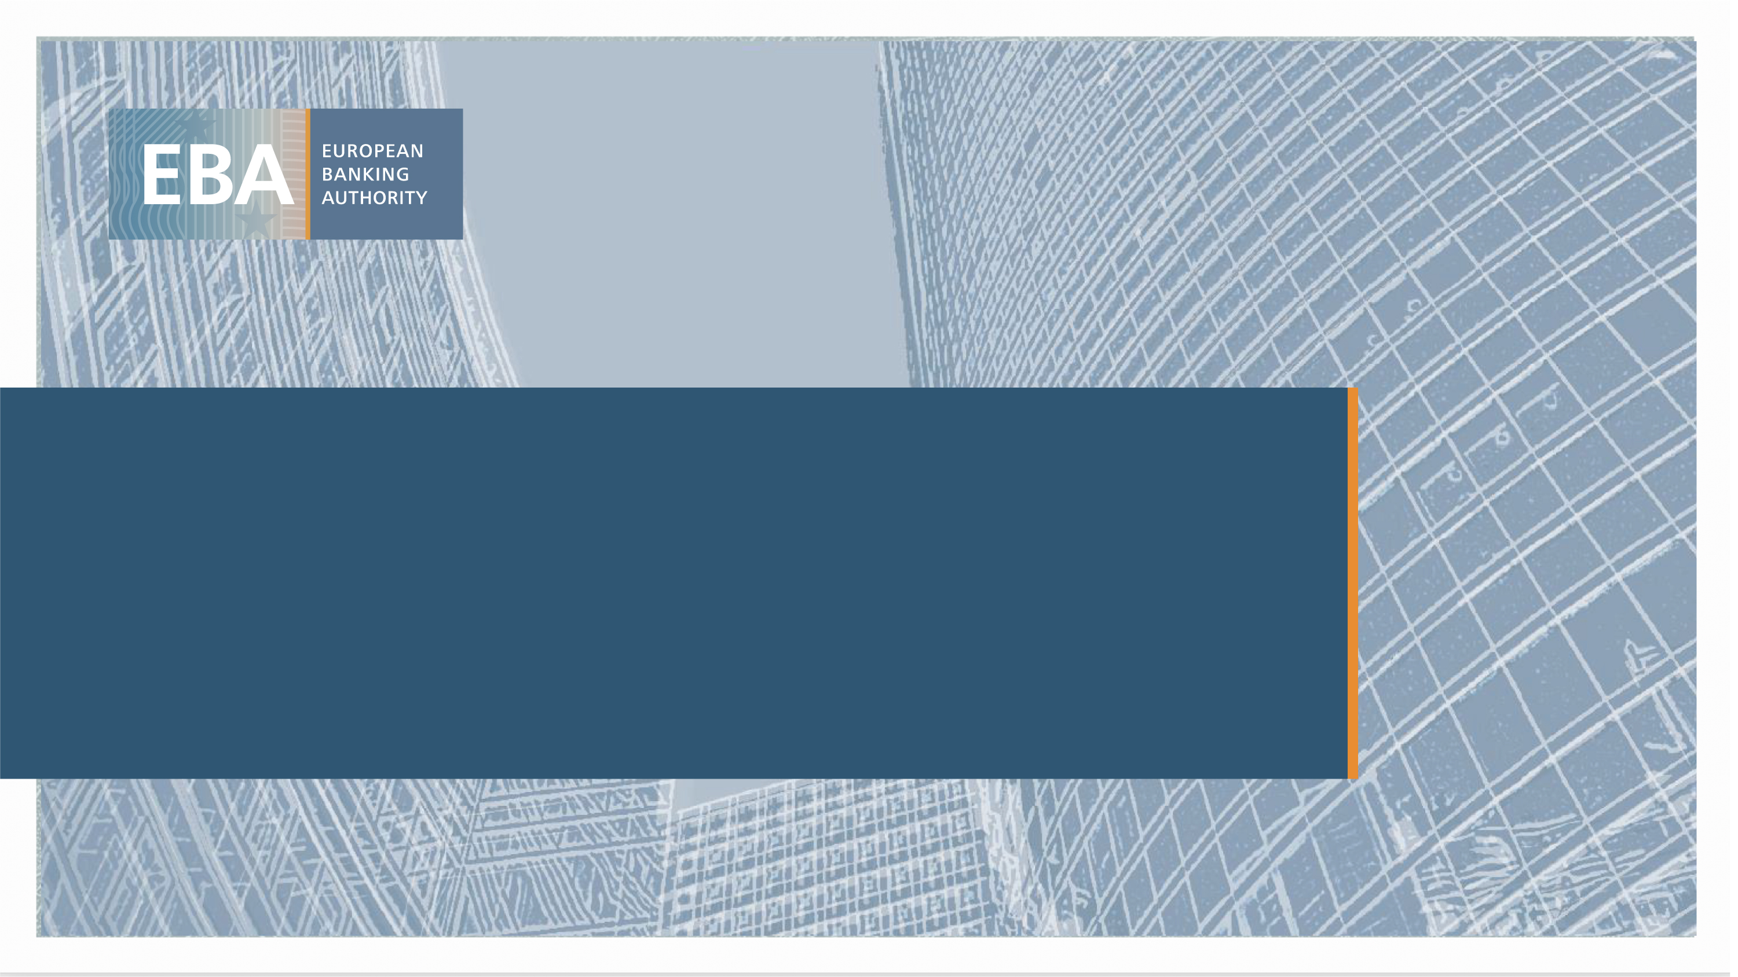
Impacts of extreme weather events on mortgage risks and their evolution under climate change: A case study on Florida
Discussant: Davide Vioto (European Banking Authority)
2022 EBA Policy Research Workshop – Paris, European Banking Authority premises.

Slide 2
Main summary
  Despite major concerns among regulators and practitioners on the impacts of climate change on credit risk, the academic literature on this topic is a relatively new research field.
  This paper contribute by
    Providing a model of mortgage default and prepayment that accounts for risks due to extreme weather events;
    Analyzing the impact of tropical cyclones and heavy rainfall events on mortgage risk in Florida; and
    Projecting future changes in flood risk exposure induced by climate change.
  Results show that the inclusion of weather-related variables could lead to more accurate default and prepayment predictions and that climate change can substantially increase default risk in flood prone areas:
    Borrowers exposed to hurricanes have higher probability of default than when tropical cyclones do not occur, with no significant finding for the prepayment rate.
    Positive and statistically significant impact of intense rain events on default probability when they occur in areas with a high percentage of properties that are at risk for flood damage, with a tendence to discourage prepayment.
    Borrowers have incentives to keep a loan (i.e., not prepay) as this can limit their loss and shift it to the lender - option to default if insurance fails to pay.

Slide 3
Strong points of this paper
  Authors explain clearly why their approach has an added value compared to existing approaches.
  Datasets used (combination of Moody's Analytics, FRED, First Street Foundation, National Flood Insurance Program, National Hurricane Center, and Copernicus).
  Variables, methodology and empirical results are well described.
  This paper represents an early contribution in investigating the relationship between climate change and credit risk.

Slide 4
Room for improvement?
  The literature review in Section 2 might be too generic. The authors should focus on describing in more detail the methods and results of previous quantitative studies that have also analysed the effects of climate change on credit risk.
  Authors might consider performing their analysis by using various delinquency stages that could be defined with variable named mbadelinqstatus – i.e., do the results change according to a different threshold of delinquency stage? This might be particularly relevant because 50% of loans in the sample terminate already through default.
  The economic interpretation of most of the results is quite intuitive and seems to be in-line with the literature discussed. Hence it is not clear to me what is the exact contribution to the literature. It would be useful if the hypotheses were presented as a way to settle some debate within the literature more than deal with an open question.
  “[...] it seems necessary to systematically account for the impact of extreme weather events in credit risk assessment” Could policy implications be drawn from this analysis?
  Did the authors consider to extend their studies to other extreme climate events (see NCEI or , https://www.floridadisaster.org/hazards/wildfire/ for wildfire)?

